Slide 1
Minimax and Alpha-Beta Pruning

Slide 2

Review: Adversarial Search (Minimax)
Minimax search:
A state-space search tree
Players alternate turns
Compute each node’s minimax value: the best achievable utility against a rational (optimal) adversary
Minimax values: computed recursively
5
max
2
5
min
8
2
5
6
Terminal values: part of the game
CIS 521 | 2
Notes:
Slide from Dan Klien

Slide 3
Review: Minimax Implementation
def max-value(state):
if the state is a terminal state:
return the state’s utility
initialize v = -∞
for each successor of state:
v = max(v, min-value(successor))
return v
def min-value(state):
if the state is a terminal state:
return the state’s utility
initialize v = +∞
for each successor of state:
v = min(v, max-value(successor))
return v
CIS 521 | 3
Notes:
Slide from Dan Klien

Slide 4
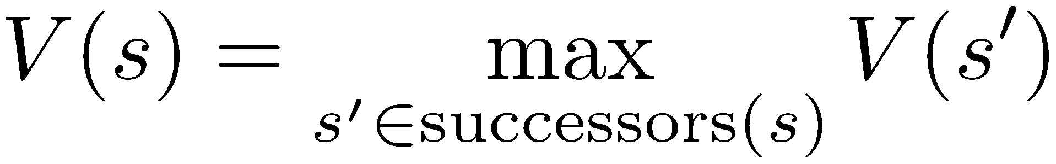
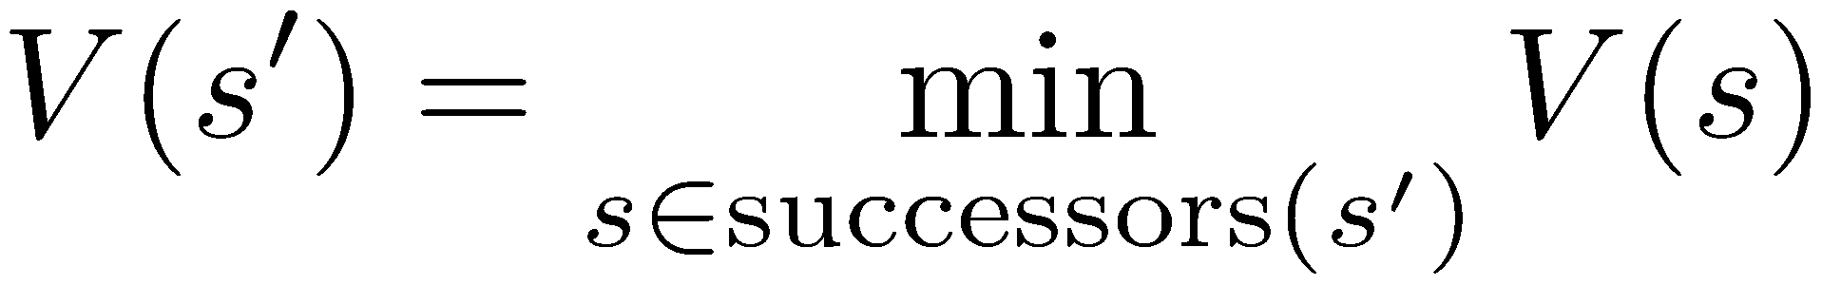
Minimax Example
-∞
def max-value(state):
if the state is a terminal state:
return the state’s utility
initialize v = -∞
for each successor of state:
v = max(v, min-value(successor))
return v
def min-value(state):
if the state is a terminal state:
return the state’s utility
initialize v = +∞
for each successor of state:
v = min(v, max-value(successor))
return v
Notes:
.

Slide 5
Minimax Example
-∞
def max-value(state):
if the state is a terminal state:
return the state’s utility
initialize v = -∞
for each successor of state:
v = max(v, min-value(successor))
return v
def min-value(state):
if the state is a terminal state:
return the state’s utility
initialize v = +∞
for each successor of state:
v = min(v, max-value(successor))
return v
Notes:
.

Slide 6
Minimax Example
-∞
def max-value(state):
if the state is a terminal state:
return the state’s utility
initialize v = -∞
for each successor of state:
v = max(v, min-value(successor))
return v
def min-value(state):
if the state is a terminal state:
return the state’s utility
initialize v = +∞
for each successor of state:
v = min(v, max-value(successor))
return v
Notes:
.

Slide 7
Minimax Example
-∞
+∞
def max-value(state):
if the state is a terminal state:
return the state’s utility
initialize v = -∞
for each successor of state:
v = max(v, min-value(successor))
return v
def min-value(state):
if the state is a terminal state:
return the state’s utility
initialize v = +∞
for each successor of state:
v = min(v, max-value(successor))
return v
Notes:
.

Slide 8
Minimax Example
-∞
+∞
def max-value(state):
if the state is a terminal state:
return the state’s utility
initialize v = -∞
for each successor of state:
v = max(v, min-value(successor))
return v
def min-value(state):
if the state is a terminal state:
return the state’s utility
initialize v = +∞
for each successor of state:
v = min(v, max-value(successor))
return v
Notes:
.

Slide 9
Minimax Example
-∞
+∞
def max-value(state):
if the state is a terminal state:
return the state’s utility
initialize v = -∞
for each successor of state:
v = max(v, min-value(successor))
return v
def min-value(state):
if the state is a terminal state:
return the state’s utility
initialize v = +∞
for each successor of state:
v = min(v, max-value(successor))
return v
Notes:
.

Slide 10
Minimax Example
-∞
+∞
def max-value(state):
if the state is a terminal state:
return the state’s utility
initialize v = -∞
for each successor of state:
v = max(v, min-value(successor))
return v
def min-value(state):
if the state is a terminal state:
return the state’s utility
initialize v = +∞
for each successor of state:
v = min(v, max-value(successor))
return v
Notes:
.

Slide 11
Minimax Example
-∞
3
3
def max-value(state):
if the state is a terminal state:
return the state’s utility
initialize v = -∞
for each successor of state:
v = max(v, min-value(successor))
return v
def min-value(state):
if the state is a terminal state:
return the state’s utility
initialize v = +∞
for each successor of state:
v = min(v, max-value(successor))
return v
Notes:
.

Slide 12
Minimax Example
-∞
3
3
8
def max-value(state):
if the state is a terminal state:
return the state’s utility
initialize v = -∞
for each successor of state:
v = max(v, min-value(successor))
return v
def min-value(state):
if the state is a terminal state:
return the state’s utility
initialize v = +∞
for each successor of state:
v = min(v, max-value(successor))
return v
Notes:
.

Slide 13
Minimax Example
-∞
3
3
8
def max-value(state):
if the state is a terminal state:
return the state’s utility
initialize v = -∞
for each successor of state:
v = max(v, min-value(successor))
return v
def min-value(state):
if the state is a terminal state:
return the state’s utility
initialize v = +∞
for each successor of state:
v = min(v, max-value(successor))
return v
Notes:
.

Slide 14
Minimax Example
-∞
3
3
8
12
def max-value(state):
if the state is a terminal state:
return the state’s utility
initialize v = -∞
for each successor of state:
v = max(v, min-value(successor))
return v
def min-value(state):
if the state is a terminal state:
return the state’s utility
initialize v = +∞
for each successor of state:
v = min(v, max-value(successor))
return v
Notes:
.

Slide 15
Minimax Example
-∞
3
3
8
12
def max-value(state):
if the state is a terminal state:
return the state’s utility
initialize v = -∞
for each successor of state:
v = max(v, min-value(successor))
return v
def min-value(state):
if the state is a terminal state:
return the state’s utility
initialize v = +∞
for each successor of state:
v = min(v, max-value(successor))
return v
Notes:
.

Slide 16
Minimax Example
-∞
3
3
8
12
def max-value(state):
if the state is a terminal state:
return the state’s utility
initialize v = -∞
for each successor of state:
v = max(v, min-value(successor))
return v
def min-value(state):
if the state is a terminal state:
return the state’s utility
initialize v = +∞
for each successor of state:
v = min(v, max-value(successor))
return v
Notes:
.

Slide 17
Minimax Example
3
3
3
8
12
def max-value(state):
if the state is a terminal state:
return the state’s utility
initialize v = -∞
for each successor of state:
v = max(v, min-value(successor))
return v
def min-value(state):
if the state is a terminal state:
return the state’s utility
initialize v = +∞
for each successor of state:
v = min(v, max-value(successor))
return v
Notes:
.

Slide 18
Minimax Example
3
3
3
8
12
def max-value(state):
if the state is a terminal state:
return the state’s utility
initialize v = -∞
for each successor of state:
v = max(v, min-value(successor))
return v
def min-value(state):
if the state is a terminal state:
return the state’s utility
initialize v = +∞
for each successor of state:
v = min(v, max-value(successor))
return v
Notes:
.

Slide 19
Minimax Example
3
3
+∞
3
8
12
def max-value(state):
if the state is a terminal state:
return the state’s utility
initialize v = -∞
for each successor of state:
v = max(v, min-value(successor))
return v
def min-value(state):
if the state is a terminal state:
return the state’s utility
initialize v = +∞
for each successor of state:
v = min(v, max-value(successor))
return v
Notes:
.

Slide 20
Minimax Example
3
3
+∞
3
8
12
def max-value(state):
if the state is a terminal state:
return the state’s utility
initialize v = -∞
for each successor of state:
v = max(v, min-value(successor))
return v
def min-value(state):
if the state is a terminal state:
return the state’s utility
initialize v = +∞
for each successor of state:
v = min(v, max-value(successor))
return v
Notes:
.

Slide 21
Minimax Example
3
3
+∞
3
8
12
def max-value(state):
if the state is a terminal state:
return the state’s utility
initialize v = -∞
for each successor of state:
v = max(v, min-value(successor))
return v
def min-value(state):
if the state is a terminal state:
return the state’s utility
initialize v = +∞
for each successor of state:
v = min(v, max-value(successor))
return v
Notes:
.

Slide 22
Minimax Example
3
3
+∞
3
8
12
2
def max-value(state):
if the state is a terminal state:
return the state’s utility
initialize v = -∞
for each successor of state:
v = max(v, min-value(successor))
return v
def min-value(state):
if the state is a terminal state:
return the state’s utility
initialize v = +∞
for each successor of state:
v = min(v, max-value(successor))
return v
Notes:
.

Slide 23
Minimax Example
3
3
2
3
8
12
2
def max-value(state):
if the state is a terminal state:
return the state’s utility
initialize v = -∞
for each successor of state:
v = max(v, min-value(successor))
return v
def min-value(state):
if the state is a terminal state:
return the state’s utility
initialize v = +∞
for each successor of state:
v = min(v, max-value(successor))
return v
Notes:
.

Slide 24
Minimax Example
3
3
2
3
8
12
2
4
def max-value(state):
if the state is a terminal state:
return the state’s utility
initialize v = -∞
for each successor of state:
v = max(v, min-value(successor))
return v
def min-value(state):
if the state is a terminal state:
return the state’s utility
initialize v = +∞
for each successor of state:
v = min(v, max-value(successor))
return v
Notes:
.

Slide 25
Minimax Example
3
3
2
3
8
12
2
4
def max-value(state):
if the state is a terminal state:
return the state’s utility
initialize v = -∞
for each successor of state:
v = max(v, min-value(successor))
return v
def min-value(state):
if the state is a terminal state:
return the state’s utility
initialize v = +∞
for each successor of state:
v = min(v, max-value(successor))
return v
Notes:
.

Slide 26
Minimax Example
3
3
2
3
8
12
2
4
6
def max-value(state):
if the state is a terminal state:
return the state’s utility
initialize v = -∞
for each successor of state:
v = max(v, min-value(successor))
return v
def min-value(state):
if the state is a terminal state:
return the state’s utility
initialize v = +∞
for each successor of state:
v = min(v, max-value(successor))
return v
Notes:
.

Slide 27
Minimax Example
3
3
2
3
8
12
2
4
6
def max-value(state):
if the state is a terminal state:
return the state’s utility
initialize v = -∞
for each successor of state:
v = max(v, min-value(successor))
return v
def min-value(state):
if the state is a terminal state:
return the state’s utility
initialize v = +∞
for each successor of state:
v = min(v, max-value(successor))
return v
Notes:
.

Slide 28
Minimax Example
3
3
2
3
8
12
2
4
6
def max-value(state):
if the state is a terminal state:
return the state’s utility
initialize v = -∞
for each successor of state:
v = max(v, min-value(successor))
return v
def min-value(state):
if the state is a terminal state:
return the state’s utility
initialize v = +∞
for each successor of state:
v = min(v, max-value(successor))
return v
Notes:
.

Slide 29
Minimax Example
3
3
2
3
8
12
2
4
6
def max-value(state):
if the state is a terminal state:
return the state’s utility
initialize v = -∞
for each successor of state:
v = max(v, min-value(successor))
return v
def min-value(state):
if the state is a terminal state:
return the state’s utility
initialize v = +∞
for each successor of state:
v = min(v, max-value(successor))
return v
Notes:
.

Slide 30
Minimax Example
3
3
2
+∞
3
8
12
2
4
6
def max-value(state):
if the state is a terminal state:
return the state’s utility
initialize v = -∞
for each successor of state:
v = max(v, min-value(successor))
return v
def min-value(state):
if the state is a terminal state:
return the state’s utility
initialize v = +∞
for each successor of state:
v = min(v, max-value(successor))
return v
Notes:
.

Slide 31
Minimax Example
3
3
2
+∞
3
8
12
2
4
6
def max-value(state):
if the state is a terminal state:
return the state’s utility
initialize v = -∞
for each successor of state:
v = max(v, min-value(successor))
return v
def min-value(state):
if the state is a terminal state:
return the state’s utility
initialize v = +∞
for each successor of state:
v = min(v, max-value(successor))
return v
Notes:
.

Slide 32
Minimax Example
3
3
2
+∞
3
8
12
2
4
6
def max-value(state):
if the state is a terminal state:
return the state’s utility
initialize v = -∞
for each successor of state:
v = max(v, min-value(successor))
return v
def min-value(state):
if the state is a terminal state:
return the state’s utility
initialize v = +∞
for each successor of state:
v = min(v, max-value(successor))
return v
Notes:
.

Slide 33
Minimax Example
3
3
2
+∞
3
8
12
2
4
6
14
def max-value(state):
if the state is a terminal state:
return the state’s utility
initialize v = -∞
for each successor of state:
v = max(v, min-value(successor))
return v
def min-value(state):
if the state is a terminal state:
return the state’s utility
initialize v = +∞
for each successor of state:
v = min(v, max-value(successor))
return v
Notes:
.

Slide 34
Minimax Example
3
3
2
14
3
8
12
2
4
6
14
def max-value(state):
if the state is a terminal state:
return the state’s utility
initialize v = -∞
for each successor of state:
v = max(v, min-value(successor))
return v
def min-value(state):
if the state is a terminal state:
return the state’s utility
initialize v = +∞
for each successor of state:
v = min(v, max-value(successor))
return v
Notes:
.

Slide 35
Minimax Example
3
3
2
14
3
8
12
2
4
6
14
5
def max-value(state):
if the state is a terminal state:
return the state’s utility
initialize v = -∞
for each successor of state:
v = max(v, min-value(successor))
return v
def min-value(state):
if the state is a terminal state:
return the state’s utility
initialize v = +∞
for each successor of state:
v = min(v, max-value(successor))
return v
Notes:
.

Slide 36
Minimax Example
3
3
2
5
3
8
12
2
4
6
14
5
def max-value(state):
if the state is a terminal state:
return the state’s utility
initialize v = -∞
for each successor of state:
v = max(v, min-value(successor))
return v
def min-value(state):
if the state is a terminal state:
return the state’s utility
initialize v = +∞
for each successor of state:
v = min(v, max-value(successor))
return v
Notes:
.

Slide 37
Minimax Example
3
3
2
5
3
8
12
2
4
6
14
5
2
def max-value(state):
if the state is a terminal state:
return the state’s utility
initialize v = -∞
for each successor of state:
v = max(v, min-value(successor))
return v
def min-value(state):
if the state is a terminal state:
return the state’s utility
initialize v = +∞
for each successor of state:
v = min(v, max-value(successor))
return v
Notes:
.

Slide 38
Minimax Example
3
3
2
2
3
8
12
2
4
6
14
5
2
def max-value(state):
if the state is a terminal state:
return the state’s utility
initialize v = -∞
for each successor of state:
v = max(v, min-value(successor))
return v
def min-value(state):
if the state is a terminal state:
return the state’s utility
initialize v = +∞
for each successor of state:
v = min(v, max-value(successor))
return v
Notes:
.

Slide 39
Minimax Example
3
3
2
2
3
8
12
2
4
6
14
5
2
def max-value(state):
if the state is a terminal state:
return the state’s utility
initialize v = -∞
for each successor of state:
v = max(v, min-value(successor))
return v
def min-value(state):
if the state is a terminal state:
return the state’s utility
initialize v = +∞
for each successor of state:
v = min(v, max-value(successor))
return v
Notes:
.

Slide 40
Minimax Example
3
3
2
2
3
8
12
2
4
6
14
5
2
def max-value(state):
if the state is a terminal state:
return the state’s utility
initialize v = -∞
for each successor of state:
v = max(v, min-value(successor))
return v
def min-value(state):
if the state is a terminal state:
return the state’s utility
initialize v = +∞
for each successor of state:
v = min(v, max-value(successor))
return v
Notes:
.

Slide 41
Minimax Example
3
3
2
2
3
8
12
2
4
6
14
5
2
def max-value(state):
if the state is a terminal state:
return the state’s utility
initialize v = -∞
for each successor of state:
v = max(v, min-value(successor))
return v
def min-value(state):
if the state is a terminal state:
return the state’s utility
initialize v = +∞
for each successor of state:
v = min(v, max-value(successor))
return v
Notes:
.

Slide 42
Minimax Example
3
3
2
2
3
8
12
2
4
6
14
5
2
def max-value(state):
if the state is a terminal state:
return the state’s utility
initialize v = -∞
for each successor of state:
v = max(v, min-value(successor))
return v
def min-value(state):
if the state is a terminal state:
return the state’s utility
initialize v = +∞
for each successor of state:
v = min(v, max-value(successor))
return v
Notes:
.

Slide 43
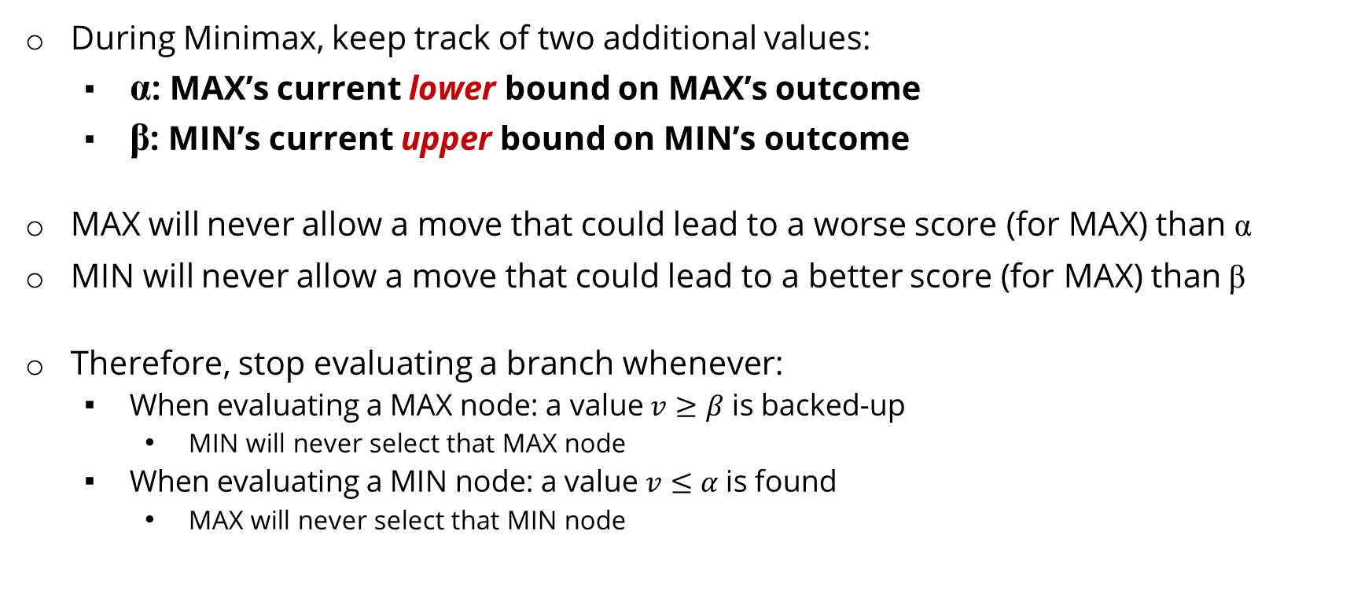
Alpha-Beta Pruning
For α think “at least”
During Minimax, keep track of two additional values:
α: MAX’s current lower bound on MAX’s outcome
β: MIN’s current upper bound on MIN’s outcome
MAX will never allow a move that could lead to a worse score (for MAX) than α
MIN will never allow a move that could lead to a better score (for MAX) than β
Therefore, stop evaluating a branch whenever:
When evaluating a MAX node: a value $v≥β$ is backed-up
MIN will never select that MAX node
When evaluating a MIN node: a value $v≤α$is found
MAX will never select that MIN node
For β think “at most”
CIS 521 | 5
Notes:
The number of game states is exponential in the depth of the tree. b^m where b is the branching factor and m is the max depth. We can’t eliminate the exponent but we can sometimes cut it in half via pruning.

Slide 44
Alpha-Beta Pruning Example
α=-∞
β =+∞
-∞
Notes:
. During Minimax, keep track of two additional values:
α: MAX’s current lower bound on MAX’s outcome
β: MIN’s current upper bound on MIN’s outcome
MAX will never allow a move that could lead to a worse score (for MAX) than α
MIN will never allow a move that could lead to a better score (for MAX) than β
Therefore, stop evaluating a branch whenever:
When evaluating a MAX node: a value $v≥β$ is backed-up
MIN will never select that MAX node
When evaluating a MIN node: a value $v≤α$is found
MAX will never select that MIN node

Slide 45
Alpha-Beta Pruning Example
α=-∞
β =+∞
-∞
α=-∞
β =+∞
+∞
Notes:
During Minimax, keep track of two additional values:
α: MAX’s current lower bound on MAX’s outcome
β: MIN’s current upper bound on MIN’s outcome
MAX will never allow a move that could lead to a worse score (for MAX) than α
MIN will never allow a move that could lead to a better score (for MAX) than β
Therefore, stop evaluating a branch whenever:
When evaluating a MAX node: a value $v≥β$ is backed-up
MIN will never select that MAX node
When evaluating a MIN node: a value $v≤α$is found
MAX will never select that MIN node

Slide 46
Alpha-Beta Pruning Example
α=-∞
β =+∞
-∞
α=-∞
β =3
3
3
Notes:
During Minimax, keep track of two additional values:
α: MAX’s current lower bound on MAX’s outcome
β: MIN’s current upper bound on MIN’s outcome
MAX will never allow a move that could lead to a worse score (for MAX) than α
MIN will never allow a move that could lead to a better score (for MAX) than β
Therefore, stop evaluating a branch whenever:
When evaluating a MAX node: a value $v≥β$ is backed-up
MIN will never select that MAX node
When evaluating a MIN node: a value $v≤α$is found
MAX will never select that MIN node

Slide 47
Alpha-Beta Pruning Example
α=-∞
β =+∞
-∞
α=-∞
β =3
3
3
12
Notes:
During Minimax, keep track of two additional values:
α: MAX’s current lower bound on MAX’s outcome
β: MIN’s current upper bound on MIN’s outcome
MAX will never allow a move that could lead to a worse score (for MAX) than α
MIN will never allow a move that could lead to a better score (for MAX) than β
Therefore, stop evaluating a branch whenever:
When evaluating a MAX node: a value $v≥β$ is backed-up
MIN will never select that MAX node
When evaluating a MIN node: a value $v≤α$is found
MAX will never select that MIN node

Slide 48
Alpha-Beta Pruning Example
α=-∞
β =+∞
-∞
α=-∞
β =3
3
3
12
8
Notes:
During Minimax, keep track of two additional values:
α: MAX’s current lower bound on MAX’s outcome
β: MIN’s current upper bound on MIN’s outcome
MAX will never allow a move that could lead to a worse score (for MAX) than α
MIN will never allow a move that could lead to a better score (for MAX) than β
Therefore, stop evaluating a branch whenever:
When evaluating a MAX node: a value $v≥β$ is backed-up
MIN will never select that MAX node
When evaluating a MIN node: a value $v≤α$is found
MAX will never select that MIN node

Slide 49
Alpha-Beta Pruning Example
α=-∞
β =+∞
-∞
α=3
β =3
3
3
12
8
Notes:
During Minimax, keep track of two additional values:
α: MAX’s current lower bound on MAX’s outcome
β: MIN’s current upper bound on MIN’s outcome
MAX will never allow a move that could lead to a worse score (for MAX) than α
MIN will never allow a move that could lead to a better score (for MAX) than β
Therefore, stop evaluating a branch whenever:
When evaluating a MAX node: a value $v≥β$ is backed-up
MIN will never select that MAX node
When evaluating a MIN node: a value $v≤α$is found
MAX will never select that MIN node

Slide 50
Alpha-Beta Pruning Example
α=3
β =+∞
-∞
α=3
β =3
3
3
12
8
Notes:
During Minimax, keep track of two additional values:
α: MAX’s current lower bound on MAX’s outcome
β: MIN’s current upper bound on MIN’s outcome
MAX will never allow a move that could lead to a worse score (for MAX) than α
MIN will never allow a move that could lead to a better score (for MAX) than β
Therefore, stop evaluating a branch whenever:
When evaluating a MAX node: a value $v≥β$ is backed-up
MIN will never select that MAX node
When evaluating a MIN node: a value $v≤α$is found
MAX will never select that MIN node

Slide 51
Alpha-Beta Pruning Example
α=3
β =+∞
3
α=3
β =3
α=-∞
β =+∞
3
+∞
3
12
8
Notes:
During Minimax, keep track of two additional values:
α: MAX’s current lower bound on MAX’s outcome
β: MIN’s current upper bound on MIN’s outcome
MAX will never allow a move that could lead to a worse score (for MAX) than α
MIN will never allow a move that could lead to a better score (for MAX) than β
Therefore, stop evaluating a branch whenever:
When evaluating a MAX node: a value $v≥β$ is backed-up
MIN will never select that MAX node
When evaluating a MIN node: a value $v≤α$is found
MAX will never select that MIN node

Slide 52
Alpha-Beta Pruning Example
α=3
β =+∞
3
α=3
β =3
α=-∞
β =+∞
3
+∞
3
8
12
Notes:
During Minimax, keep track of two additional values:
α: MAX’s current lower bound on MAX’s outcome
β: MIN’s current upper bound on MIN’s outcome
MAX will never allow a move that could lead to a worse score (for MAX) than α
MIN will never allow a move that could lead to a better score (for MAX) than β
Therefore, stop evaluating a branch whenever:
When evaluating a MAX node: a value $v≥β$ is backed-up
MIN will never select that MAX node
When evaluating a MIN node: a value $v≤α$is found
MAX will never select that MIN node

Slide 53
Alpha-Beta Pruning Example
α=3
β =+∞
3
α=3
β =3
α=-∞
β =+∞
3
+∞
3
8
12
2
Notes:
During Minimax, keep track of two additional values:
α: MAX’s current lower bound on MAX’s outcome
β: MIN’s current upper bound on MIN’s outcome
MAX will never allow a move that could lead to a worse score (for MAX) than α
MIN will never allow a move that could lead to a better score (for MAX) than β
Therefore, stop evaluating a branch whenever:
When evaluating a MAX node: a value $v≥β$ is backed-up
MIN will never select that MAX node
When evaluating a MIN node: a value $v≤α$is found
MAX will never select that MIN node

Slide 54
Alpha-Beta Pruning Example
α=3
β =+∞
3
α=3
β =3
α=-∞
β =2
3
2
3
8
12
2
Notes:
During Minimax, keep track of two additional values:
α: MAX’s current lower bound on MAX’s outcome
β: MIN’s current upper bound on MIN’s outcome
MAX will never allow a move that could lead to a worse score (for MAX) than α
MIN will never allow a move that could lead to a better score (for MAX) than β
Therefore, stop evaluating a branch whenever:
When evaluating a MAX node: a value $v≥β$ is backed-up
MIN will never select that MAX node
When evaluating a MIN node: a value $v≤α$is found
MAX will never select that MIN node

Slide 55
Alpha-Beta Pruning Example
Value for β is 2
α=3
β =+∞
3
α=3
β =3
α=-∞
β =2
3
2
3
8
12
2
So Max will never choose 2.
But we know that this node is worth at least 3
Notes:
During Minimax, keep track of two additional values:
α: MAX’s current lower bound on MAX’s outcome
β: MIN’s current upper bound on MIN’s outcome
MAX will never allow a move that could lead to a worse score (for MAX) than α
MIN will never allow a move that could lead to a better score (for MAX) than β
Therefore, stop evaluating a branch whenever:
When evaluating a MAX node: a value $v≥β$ is backed-up
MIN will never select that MAX node
When evaluating a MIN node: a value $v≤α$is found
MAX will never select that MIN node

Slide 56
Alpha-Beta Pruning Example
α=3
β =+∞
3
α=3
β =3
α=-∞
β =2
3
2
3
8
12
2
Notes:
During Minimax, keep track of two additional values:
α: MAX’s current lower bound on MAX’s outcome
β: MIN’s current upper bound on MIN’s outcome
MAX will never allow a move that could lead to a worse score (for MAX) than α
MIN will never allow a move that could lead to a better score (for MAX) than β
Therefore, stop evaluating a branch whenever:
When evaluating a MAX node: a value $v≥β$ is backed-up
MIN will never select that MAX node
When evaluating a MIN node: a value $v≤α$is found
MAX will never select that MIN node

Slide 57
Alpha-Beta Pruning Example
α=3
β =+∞
3
α=3
β =3
α=-∞
β =2
α=-∞
β =+∞
3
2
+∞
3
8
12
2
Notes:
During Minimax, keep track of two additional values:
α: MAX’s current lower bound on MAX’s outcome
β: MIN’s current upper bound on MIN’s outcome
MAX will never allow a move that could lead to a worse score (for MAX) than α
MIN will never allow a move that could lead to a better score (for MAX) than β
Therefore, stop evaluating a branch whenever:
When evaluating a MAX node: a value $v≥β$ is backed-up
MIN will never select that MAX node
When evaluating a MIN node: a value $v≤α$is found
MAX will never select that MIN node

Slide 58
Alpha-Beta Pruning Example
α=3
β =+∞
3
α=3
β =3
α=-∞
β =2
α=-∞
β =14
3
2
14
3
8
12
2
14
Notes:
During Minimax, keep track of two additional values:
α: MAX’s current lower bound on MAX’s outcome
β: MIN’s current upper bound on MIN’s outcome
MAX will never allow a move that could lead to a worse score (for MAX) than α
MIN will never allow a move that could lead to a better score (for MAX) than β
Therefore, stop evaluating a branch whenever:
When evaluating a MAX node: a value $v≥β$ is backed-up
MIN will never select that MAX node
When evaluating a MIN node: a value $v≤α$is found
MAX will never select that MIN node

Slide 59
Alpha-Beta Pruning Example
α=3
β =14
3
α=3
β =3
α=-∞
β =2
α=-∞
β =14
3
2
14
3
8
12
2
14
Notes:
During Minimax, keep track of two additional values:
α: MAX’s current lower bound on MAX’s outcome
β: MIN’s current upper bound on MIN’s outcome
MAX will never allow a move that could lead to a worse score (for MAX) than α
MIN will never allow a move that could lead to a better score (for MAX) than β
Therefore, stop evaluating a branch whenever:
When evaluating a MAX node: a value $v≥β$ is backed-up
MIN will never select that MAX node
When evaluating a MIN node: a value $v≤α$is found
MAX will never select that MIN node

Slide 60
Alpha-Beta Pruning Example
α=3
β =14
3
α=3
β =3
α=-∞
β =2
α=-∞
β =5
3
2
5
3
8
12
2
14
5
Notes:
During Minimax, keep track of two additional values:
α: MAX’s current lower bound on MAX’s outcome
β: MIN’s current upper bound on MIN’s outcome
MAX will never allow a move that could lead to a worse score (for MAX) than α
MIN will never allow a move that could lead to a better score (for MAX) than β
Therefore, stop evaluating a branch whenever:
When evaluating a MAX node: a value $v≥β$ is backed-up
MIN will never select that MAX node
When evaluating a MIN node: a value $v≤α$is found
MAX will never select that MIN node

Slide 61
Alpha-Beta Pruning Example
α=3
β =5
3
α=3
β =3
α=-∞
β =2
α=-∞
β =5
3
2
5
3
8
12
2
14
5
Notes:
During Minimax, keep track of two additional values:
α: MAX’s current lower bound on MAX’s outcome
β: MIN’s current upper bound on MIN’s outcome
MAX will never allow a move that could lead to a worse score (for MAX) than α
MIN will never allow a move that could lead to a better score (for MAX) than β
Therefore, stop evaluating a branch whenever:
When evaluating a MAX node: a value $v≥β$ is backed-up
MIN will never select that MAX node
When evaluating a MIN node: a value $v≤α$is found
MAX will never select that MIN node

Slide 62
Alpha-Beta Pruning Example
α=3
β =5
3
α=3
β =3
α=-∞
β =2
α=-∞
β =2
3
2
2
3
8
12
2
14
5
2
Notes:
During Minimax, keep track of two additional values:
α: MAX’s current lower bound on MAX’s outcome
β: MIN’s current upper bound on MIN’s outcome
MAX will never allow a move that could lead to a worse score (for MAX) than α
MIN will never allow a move that could lead to a better score (for MAX) than β
Therefore, stop evaluating a branch whenever:
When evaluating a MAX node: a value $v≥β$ is backed-up
MIN will never select that MAX node
When evaluating a MIN node: a value $v≤α$is found
MAX will never select that MIN node

Slide 63
Alpha-Beta Pruning Example
α=3
β =3
3
α=3
β =3
α=-∞
β =2
α=2
β =2
3
2
2
3
8
12
2
14
5
2
Notes:
During Minimax, keep track of two additional values:
α: MAX’s current lower bound on MAX’s outcome
β: MIN’s current upper bound on MIN’s outcome
MAX will never allow a move that could lead to a worse score (for MAX) than α
MIN will never allow a move that could lead to a better score (for MAX) than β
Therefore, stop evaluating a branch whenever:
When evaluating a MAX node: a value $v≥β$ is backed-up
MIN will never select that MAX node
When evaluating a MIN node: a value $v≤α$is found
MAX will never select that MIN node

Slide 64
Alpha-Beta Pruning Example
α=3
β =3
3
α=3
β =3
α=-∞
β =2
α=2
β =2
3
2
2
3
8
12
2
14
5
2
Notes:
During Minimax, keep track of two additional values:
α: MAX’s current lower bound on MAX’s outcome
β: MIN’s current upper bound on MIN’s outcome
MAX will never allow a move that could lead to a worse score (for MAX) than α
MIN will never allow a move that could lead to a better score (for MAX) than β
Therefore, stop evaluating a branch whenever:
When evaluating a MAX node: a value $v≥β$ is backed-up
MIN will never select that MAX node
When evaluating a MIN node: a value $v≤α$is found
MAX will never select that MIN node

Slide 65
Alpha-Beta Pruning
α=3
β =3
3
α=3
β =3
α=-∞
β =2
α=2
β =2
3
2
2
3
8
12
2
X
X
14
5
2
α: MAX’s current lower bound on MAX’s outcome
β: MIN’s current upper bound on MIN’s outcome
α: MAX’s best option on path to root
β: MIN’s best option on path to root
Notes:
During Minimax, keep track of two additional values:
α: MAX’s current lower bound on MAX’s outcome
β: MIN’s current upper bound on MIN’s outcome
MAX will never allow a move that could lead to a worse score (for MAX) than α
MIN will never allow a move that could lead to a better score (for MAX) than β
Therefore, stop evaluating a branch whenever:
When evaluating a MAX node: a value $v≥β$ is backed-up
MIN will never select that MAX node
When evaluating a MIN node: a value $v≤α$is found
MAX will never select that MIN node

Slide 66
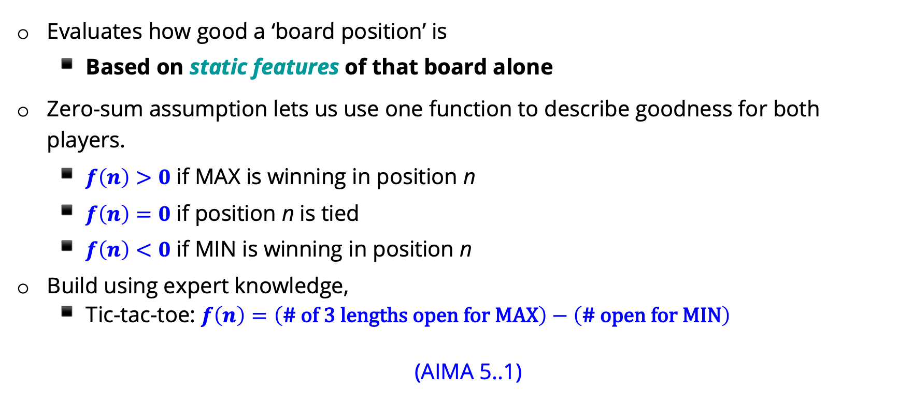
Review: Evaluation functions
Evaluates how good a ‘board position’ is
Based on static features of that board alone
Zero-sum assumption lets us use one function to describe goodness for both players.
$f\left(n\right)>0$ if MAX is winning in position n
$f\left(n\right)=0$ if position n is tied
$f\left(n\right)<0$ if MIN is winning in position n
Build using expert knowledge,
Tic-tac-toe: $f\left(n\right)=\left(\text{\# }\text{of}\text{ 3 }\text{lengths} \text{open} \text{for} \text{MAX}\right)−\left(\text{\# }\text{open} \text{for} \text{MIN}\right)$
(AIMA 5..1)
CIS 521 | 7
Notes:
.

Slide 67
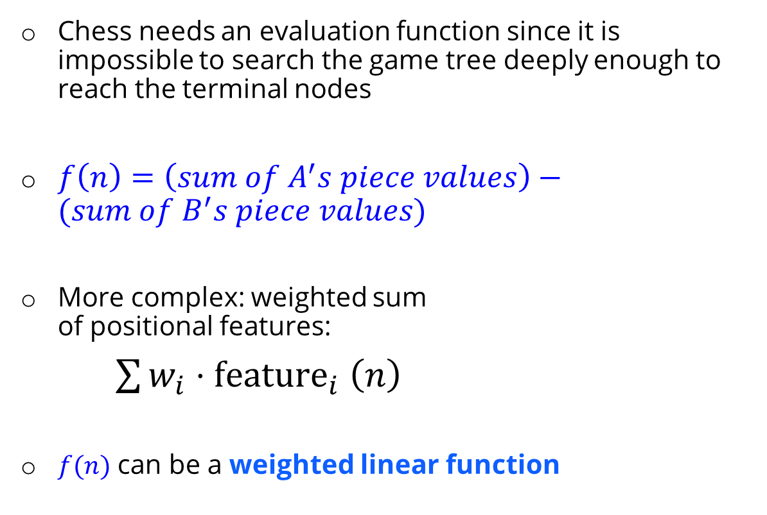
Review: Chess Evaluation Functions
Chess needs an evaluation function since it is impossible to search the game tree deeply enough to reach the terminal nodes
$f\left(n\right)=\left(sum of A^{′}s piece values\right)−(sum of B^{′}s piece values)$
More complex: weighted sum of positional features:
$\sum{w_{i}{⋅\text{feature}}_{i}\left(n\right)}$
$f(n)$ can be a weighted linear function
Pawn | 1.0
Knight | 3.0
Bishop | 3.25
Rook | 5.0
Queen | 9.0
Pieces values for a simple evaluation function often taught to novice chess players
CIS 521 | 8
Notes:
.

Slide 68
Expectimax and Utilities
Many of today’s slides are courtesy of Dan Klein and Pieter Abbeel of University of California, Berkeley

Slide 69
Uncertain Outcomes
CIS 521 | 9
Notes:
.

Slide 70
max
chance
min
10
10
9
100
Idea: Uncertain outcomes controlled by chance, not an adversary!
CIS 521 | 10
Notes:
At least 10, or otherwise just rather dead; or just 100, or otherwise rather dead; that’s yet something different than minimax or expectimax
Down arrows = min nodes
Circles = chance nodes.

Slide 71
Expectimax Search
Why wouldn’t we know what the result of an action will be?
Explicit randomness: rolling dice
Unpredictable opponents: the opponent isn’t optimal
Actions can fail: when moving a robot, wheels might slip
Values should now reflect average-case (expectimax) outcomes, not worst-case (minimax) outcomes
Expectimax search: compute the average score under optimal play
Max nodes as in minimax search
Chance nodes are like min nodes but the outcome is uncertain
Calculate their expected utilities
I.e. take weighted average (expectation) of children
Later, we’ll learn how to formalize the underlying uncertain-result problems as Markov Decision Processes
max
chance
10
10
4
10
5
9
7
100
CIS 521 | 11
Notes:
.

Slide 72
Expectimax Pseudocode
def value(state):
if the state is a terminal state: return the state’s utility
if the next agent is MAX: return max-value(state)
if the next agent is EXP: return exp-value(state)
def max-value(state):
initialize v = -∞
for each successor of state:
v = max(v, value(successor))
return v
def exp-value(state):
initialize v = 0
for each successor of state:
p = probability(successor)
v += p * value(successor)
return v
CIS 521 | 12
Notes:
Max is just like before. Exp is the expectation of what will happen next.

Slide 73
Expectimax Pseudocode
def exp-value(state):
initialize v = 0
for each successor of state:
p = probability(successor)
v += p * value(successor)
return v
1/2
1/6
1/3
8
24
-12
$v=\frac{1}{2}⋅(8)+\frac{1}{3}⋅(24)$+ $\frac{1}{6}⋅(−12)$
CIS 521 | 13
Notes:
.

Slide 74
3
12
9
2
4
6
15
6
0
CIS 521 | 14
Notes:
Here imagine that all children are equally likely.
8 … 4 …. 7

Slide 75
3
12
9
2
CIS 521 | 15
Notes:
In Minimax we were done, since 2 would always be less than 3.
Here the average of 3, 12 and 9 = 8.
Can the average be less than 2 on the middle node? YES!!! Much harder to prune.

Slide 76
400
300
…
Estimate of true expectimax value (which would require a lot of work to compute)
492
362
…
CIS 521 | 16
Notes:
Let’s image they are actually random ghosts. 2 layers of random ghost actions.
At the actual end of the game, we have the score. But we can’t do that so we have to cut the process off.
So we need some way of evaluating the

Slide 77
Probabilities
CIS 521 | 17
Notes:
.

Slide 78

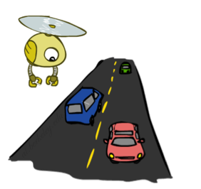
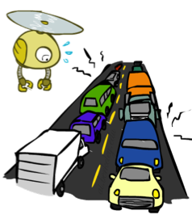
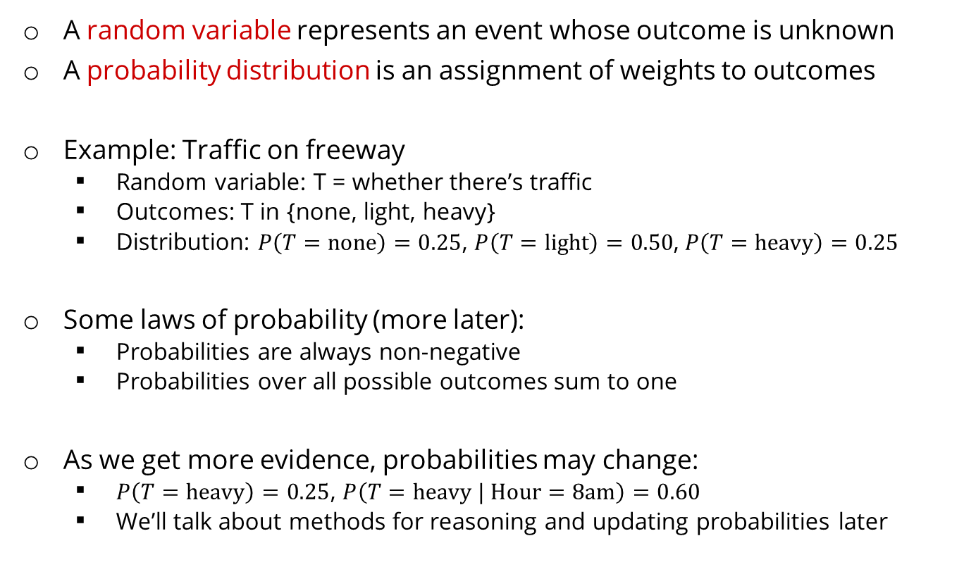
Probabilities
A random variable represents an event whose outcome is unknown
A probability distribution is an assignment of weights to outcomes
Example: Traffic on freeway
Random variable: T = whether there’s traffic
Outcomes: T in {none, light, heavy}
Distribution: $P\left(T=\text{none}\right)=0.25$, $P\left(T=\text{light}\right)=0.50$, $P\left(T=\text{heavy}\right)=0.25$
Some laws of probability (more later):
Probabilities are always non-negative
Probabilities over all possible outcomes sum to one
As we get more evidence, probabilities may change:
$P\left(T=\text{heavy}\right)=0.25$, $P\left(T=\text{heavy} | \text{Hour}=\text{8}\text{am}\right)=0.60$
We’ll talk about methods for reasoning and updating probabilities later
0.25
0.50
0.25
CIS 521 | 18
Notes:
In general, we will be computing probabilities. As we get more evidence the probabilities will change. We will look at Probabilistic Inference later in this course.

Slide 79
Probabilities
The expected value of a function of a random variable is the average, weighted by the probability distribution over outcomes
Example: How long to get to the airport?
20 min
30 min
60 min
Time:
35 min
x
+
x
+
x
Probability:
0.25
0.50
0.25
CIS 521 | 19
Notes:
.

Slide 80
What Probabilities to Use?
In expectimax search, we have a probabilistic model of how the opponent (or environment) will behave in any state
Model could be a simple uniform distribution (roll a die)
Model could be sophisticated and require a great deal of computation
We have a chance node for any outcome out of our control: opponent or environment
The model might say that adversarial actions are likely!
For now, assume each chance node magically comes along with probabilities that specify the distribution over its outcomes
Having a probabilistic belief about another agent’s action does not mean that the agent is flipping any coins!
CIS 521 | 20
Notes:
Where do the probabilities come from? For today, they come from the probability fairy. They are given by the problem definition. Later we will look at how to compute them.

Slide 81
Objectivist / frequentist answer:
Averages over repeated experiments
E.g. empirically estimating P(rain) from historical observation
Assertion about how future experiments will go (in the limit)
New evidence changes the reference class
Makes one think of inherently random events, like rolling dice
Subjectivist / Bayesian answer:
Degrees of belief about unobserved variables
E.g. an agent’s belief that it’s raining, given the temperature
E.g. agent’s belief how an opponent will behave, given the state
Often learn probabilities from past experiences (more later)
New evidence updates beliefs (more later)
CIS 521 | 21
Notes:
.

Slide 82
Quiz: Informed Probabilities
Let’s say you know that your opponent is actually running a depth 2 minimax, using the result 80% of the time, and moving randomly otherwise
Question: What tree search should you use?
Answer: Expectimax!
To figure out EACH chance node’s probabilities, you have to run a simulation of your opponent
This kind of thing gets very slow very quickly
Even worse if you have to simulate your opponent simulating you…
… except for minimax, which has the nice property that it all collapses into one game tree
0.1 0.9
CIS 521 | 22
Notes:
…Except, what if your opponent simulates you? You can get into this crazy recursive trees. If you go too far down the computation then
That only really works out for minimax.

Slide 83
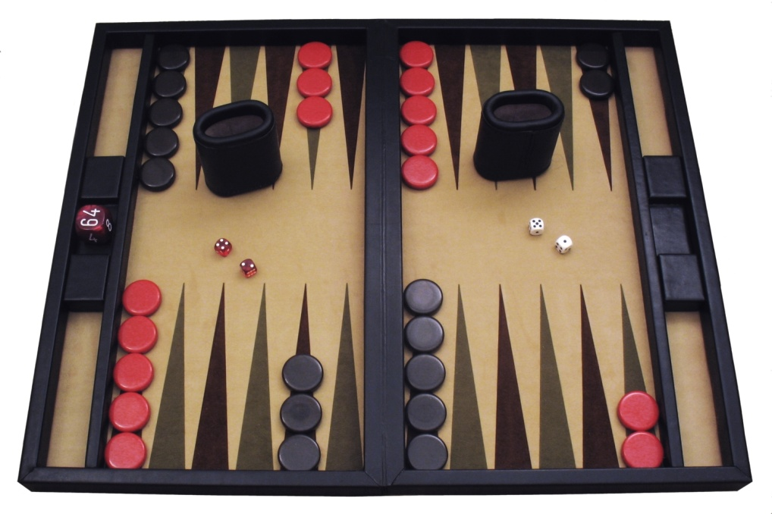
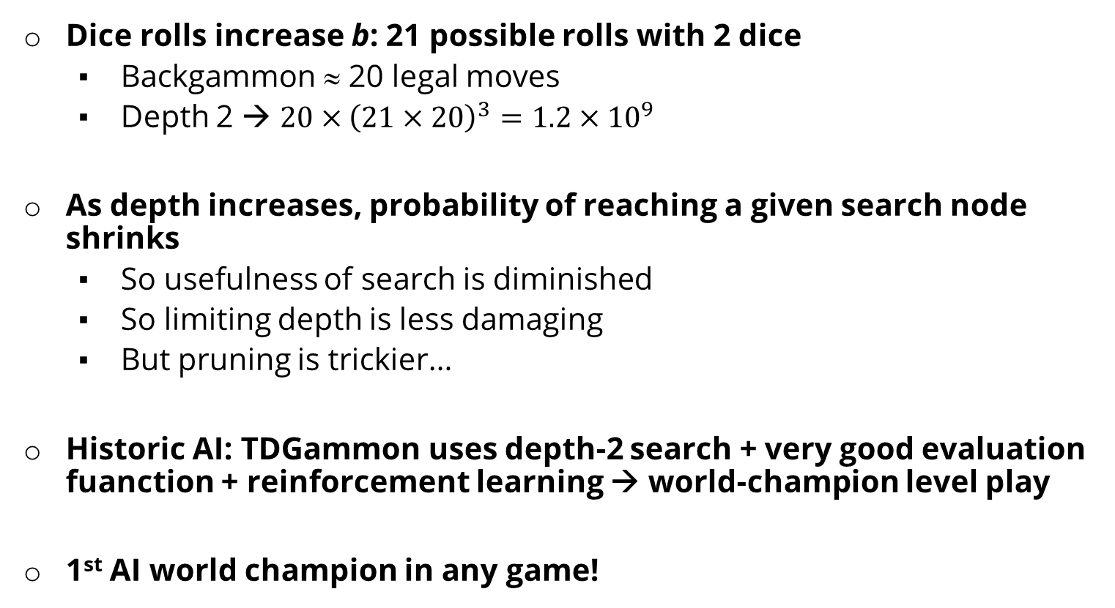
Dice rolls increase b: 21 possible rolls with 2 dice
Backgammon ≈ 20 legal moves
Depth 2 → $20×{\left(21×20\right)}^{3}=1.2×{10}^{9}$
As depth increases, probability of reaching a given search node shrinks
So usefulness of search is diminished
So limiting depth is less damaging
But pruning is trickier…
Historic AI: TDGammon uses depth-2 search + very good evaluation fuanction + reinforcement learning → world-champion level play
1st AI world champion in any game!
CIS 521 | 23
Notes:
TD-Gammon is a computer backgammon program developed in 1992 by Gerald Tesauro at IBM's Thomas J. Watson Research Center. Its name comes from the fact that it is an artificial neural net trained by a form of temporal-difference learning,

Slide 84
E.g. Backgammon
Expectiminimax
Environment is an extra “random agent” player that moves after each min/max agent
Each node computes the appropriate combination of its children
Max nodes
Chance nodes
Min nodes
CIS 521 | 24
Notes:
I move, you move. Each tie, we roll some dice. This is an expectimenimax tree.
If it’s terminal or we reached our depth limit, return utility.

Slide 85

Utilities
AIMA Chapter 16.1-16.3
CIS 521 | 25
Notes:
Everything in minimax and expectimax has referenced the notion of Utilties. The idea that there are values that you can go around either maximizing or minimizing or taking the average of.
What are these numbers? Where do they come from? How do we even know that they exist?

Slide 86
Maximum Expected Utility
Why should we average utilities? Why not minimax?
Principle of maximum expected utility:
A rational agent should choose the action that maximizes its expected utility, given its knowledge
Questions:
Where do utilities come from?
How do we know such utilities even exist?
How do we know that averaging even makes sense?
What if our behavior (preferences) can’t be described by utilities?
CIS 521 | 26
Notes:
If we have utilities, why should we ever average them?
The answer is vampire bunnies. Worst case reasoning only works if your model is able to assign very low probabilities to very bad events. You need probabilistic reasoning and averages.
This is going to lead us down the path of probabilistic reasoning.
Are humans so complex that they can’t be boiled down to these probabilities?

Slide 87
x²
0
40
20
30
0
1600
400
900
For worst-case minimax reasoning, terminal function scale doesn’t matter
We just want better states to have higher evaluations (get the ordering right)
We call this insensitivity to monotonic transformations
For average-case expectimax reasoning, we need magnitudes to be meaningful
CIS 521 | 27
Notes:
Minimax is really about the ordering of the states. A Monotonic transformation is a way of transforming a set of numbers into another set that preserves the order of the original set
In expectiax, the right tree would give me average of 20 and 25, so I would take the right branch. What about in the right tree? That would give me 800 and 650, so I would take the left branch.
The magnitudes are very important here.

Slide 88

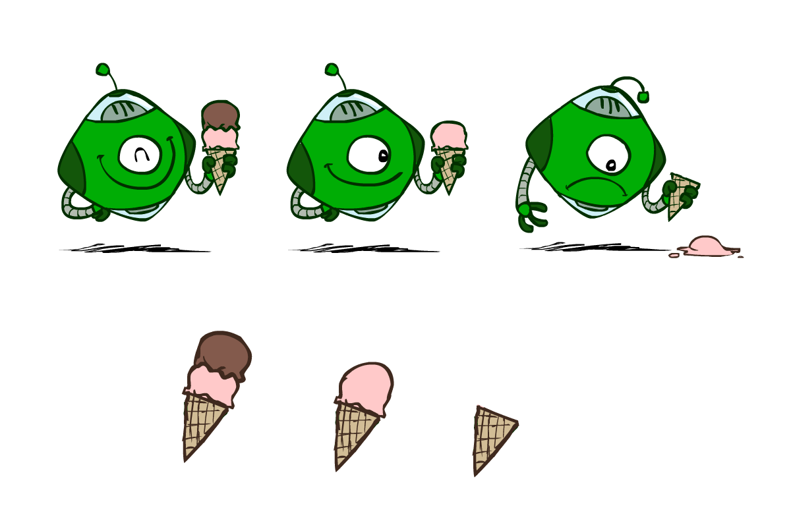
Utilities are functions from outcomes (states of the world) to real numbers that describe an agent’s preferences
Where do utilities come from?
In a game, may be simple (+1/-1)
Utilities summarize the agent’s goals
Theorem: any “rational” preferences can be summarized as a utility function
We hard-wire utilities and let behaviors emerge
Why don’t we let agents pick utilities?
Why don’t we prescribe behaviors?
CIS 521 | 28

Slide 89

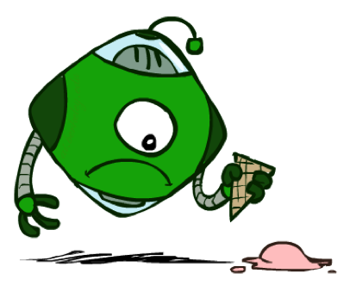

Utilities: Uncertain Outcomes
Getting ice cream
Get Single
Get Double
Oops
Whew!
CIS 521 | 29
Notes:
The robot has to choose not only between utilities, but also uncertain outcomes.

Slide 90
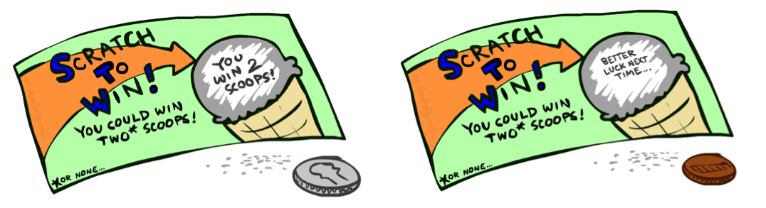
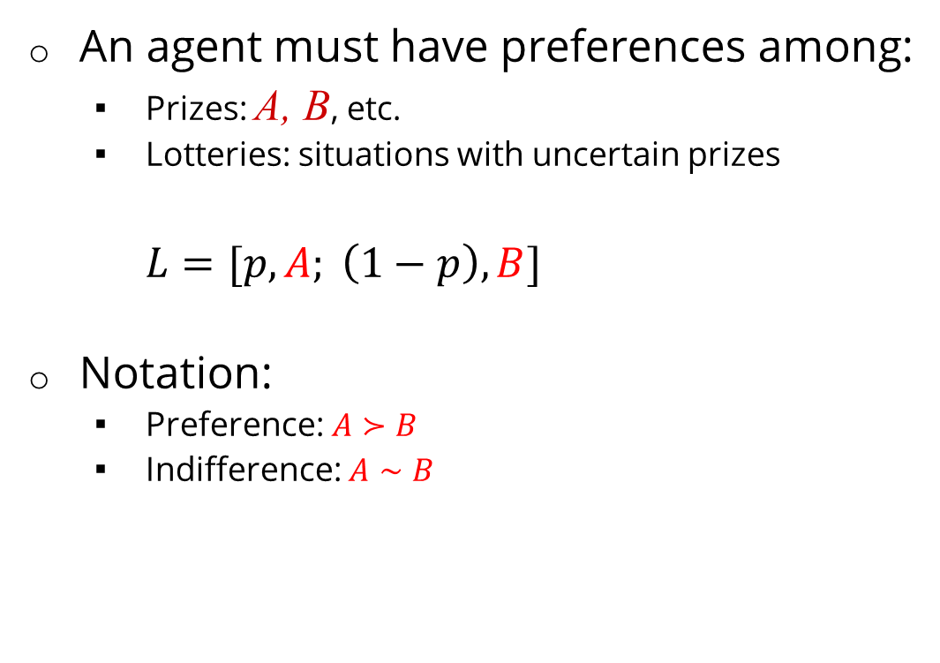
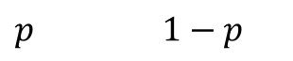
An agent must have preferences among:
Prizes: A, B, etc.
Lotteries: situations with uncertain prizes
$L=[p,A; \left(1−p\right),B]$
Notation:
Preference: $A≻B$
Indifference: $A∼B$
A Prize
A Lottery
A
$p$ $1−p$
A B
CIS 521 | 30
Notes:
A prize is a given outcome.
Lotteries are mixtures with probabilities attached.

Slide 91
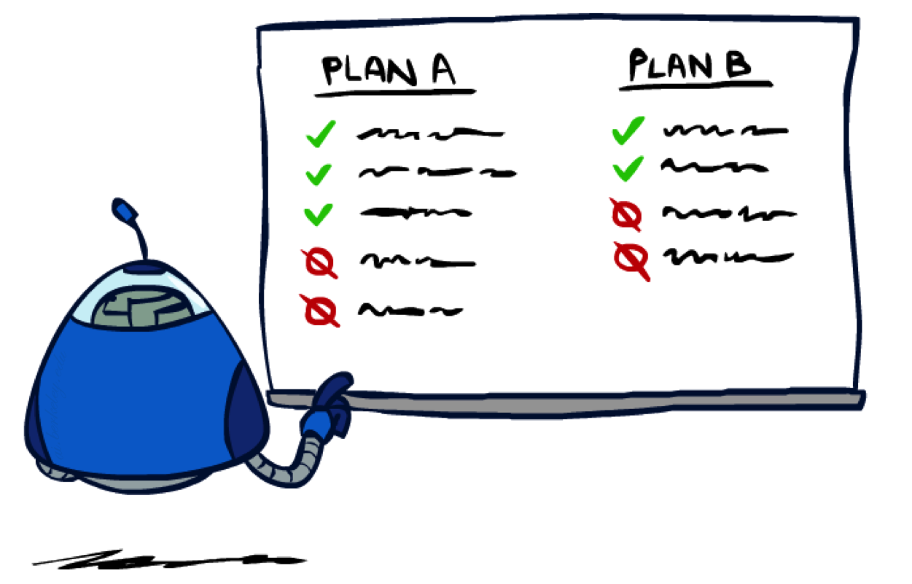
CIS 521 | 31
Notes:
Are there good preferences and bad preferences? What do we need in order to decide is an agent is rational?

Slide 92
We want some constraints on preferences before we call them rational, such as:
For example: an agent with intransitive preferences can
be induced to give away all of its money
If B > C, then an agent with C would pay (say) 1 cent to get B
If A > B, then an agent with B would pay (say) 1 cent to get A
If C > A, then an agent with A would pay (say) 1 cent to get C
Axiom of Transitivity: $(A≻B)∧(B≻C)⇒(A≻C)$
CIS 521 | 32
Notes:
Apple, banana, carrot
Some things don’t make sense.
... This is a defect in behavior.

Slide 93
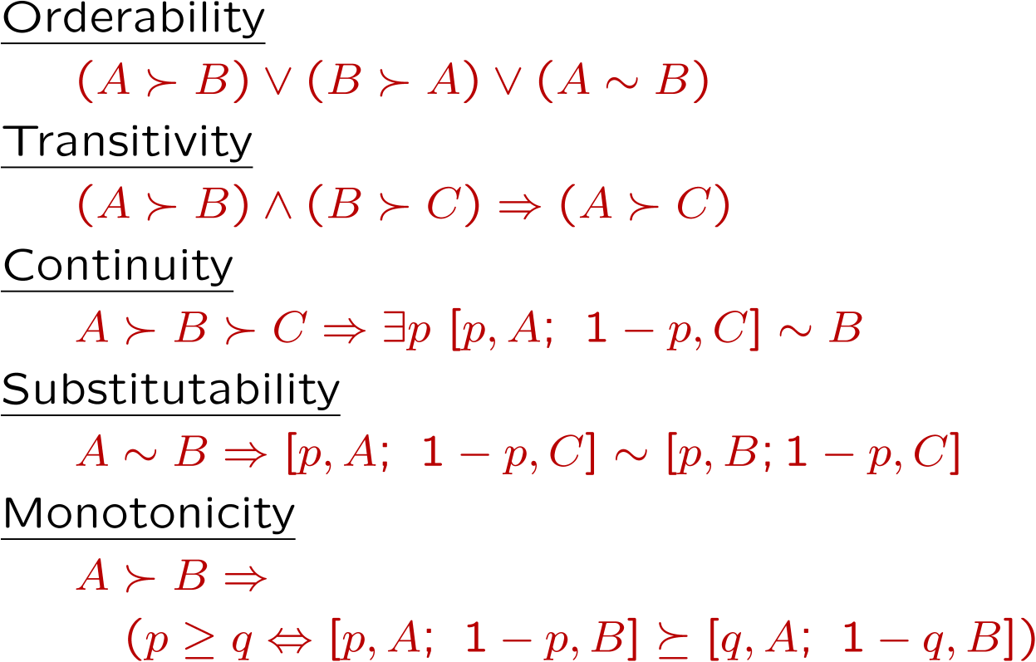

The Axioms of Rationality
Theorem: Rational preferences imply behavior describable as maximization of expected utility
CIS 521 | 33
Notes:
Orderability. You have to like A better or B better or be indifferent.
Transitivity, we just saw.
Continuity. More subtle. If you like A better than C and B is somewhere in the middle. Then there has to be some lottery between A and C, where you’re indifferent with B.
Substitutability. If they’re exchangeable on their own then they are exchangeable in a lottery.
Monotonicity. Also reasonable. If A is better than B, and you have a lottery between A and B, then you would prefer more A in the mix.
If you accept these actions, then rational preferences that obey these, then all of your behavior is describable by maximizing utilities.

Slide 94
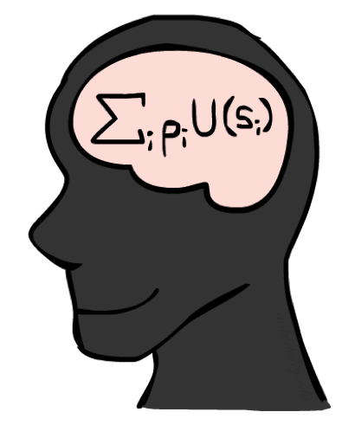
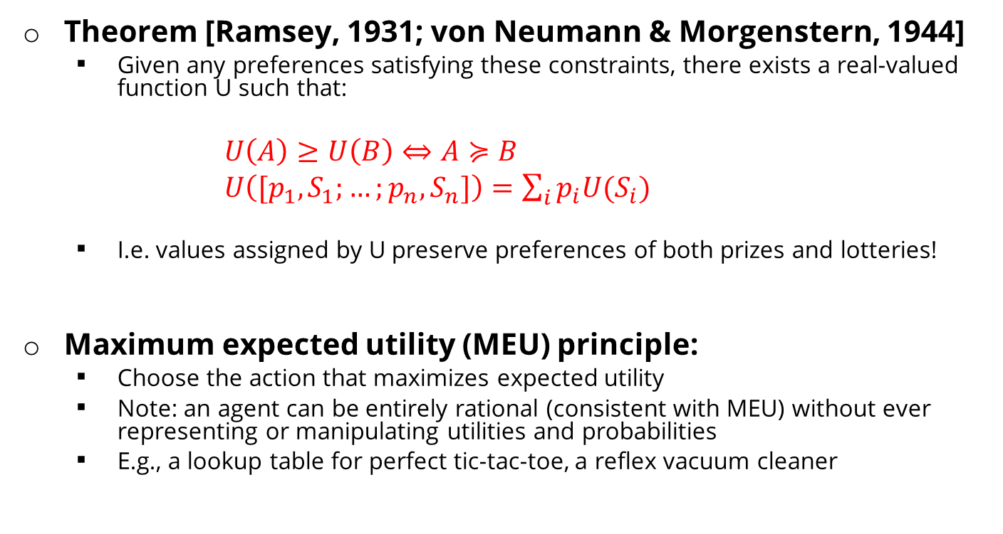
MEU Principle
Theorem [Ramsey, 1931; von Neumann & Morgenstern, 1944]
Given any preferences satisfying these constraints, there exists a real-valued function U such that:
$U\left(A\right)≥U\left(B\right)⇔A≽B$
$U\left([p_{1},S_{1};…;p_{n},S_{n}]\right)=\sum_{i}{p_{i}U(S_{i})}$
I.e. values assigned by U preserve preferences of both prizes and lotteries!
Maximum expected utility (MEU) principle:
Choose the action that maximizes expected utility
Note: an agent can be entirely rational (consistent with MEU) without ever representing or manipulating utilities and probabilities
E.g., a lookup table for perfect tic-tac-toe, a reflex vacuum cleaner
CIS 521 | 34
Notes:
Here’s the theorem.
There exists a real valued function U with the following properties.
U captures your ordinal preferences.
Utility of a lottery is the expectation of the elements of the lottery.
This means the utility captures your preference not only between prizes, but between lotteries!
It’s amazing! It means your utilities are preserved under expectation.
You want your BEHAVIORS to be consistent to the MEU Princple.

Slide 95
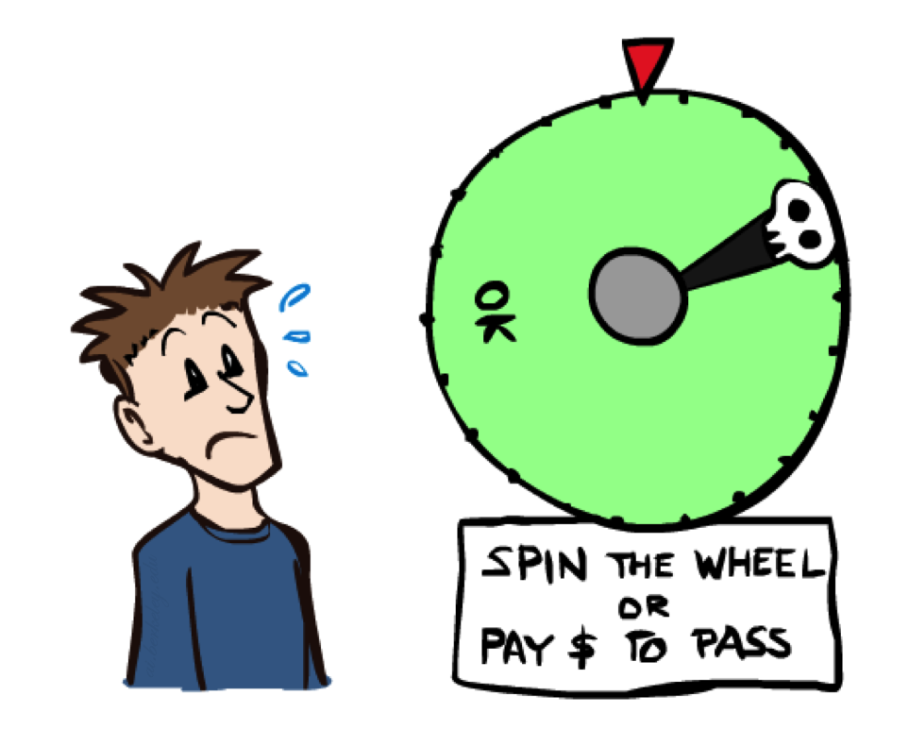
CIS 521 | 35
Notes:
You can be represented with utilities! And MEU.

Slide 96

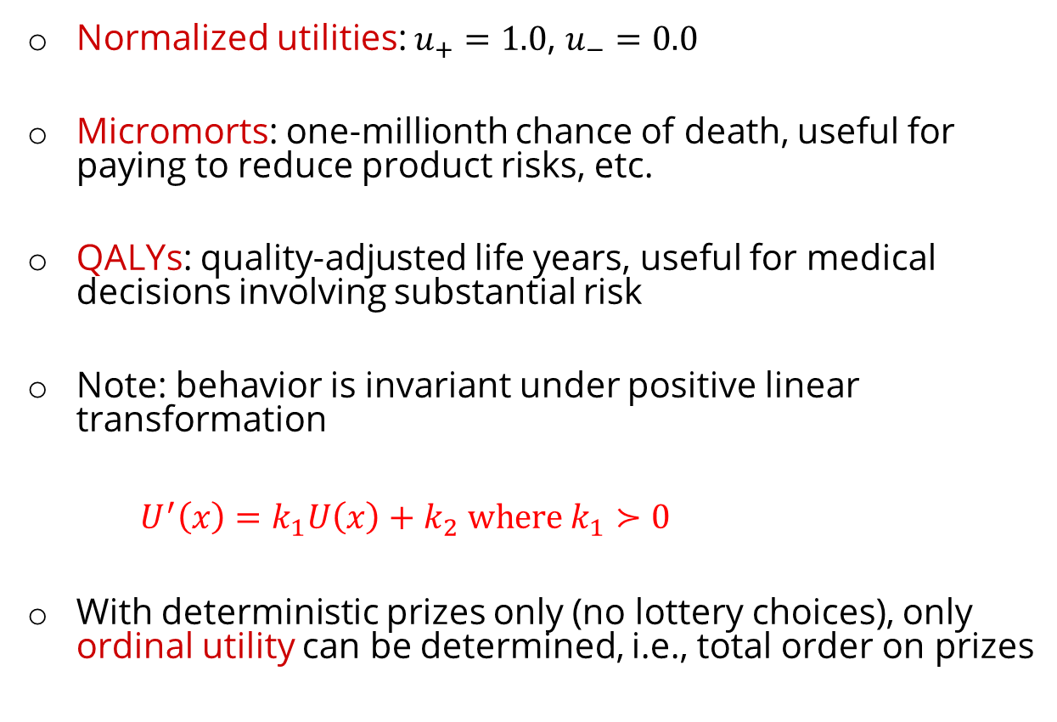
Utility Scales
Normalized utilities: $u_{+}=1.0$, $u_{−}=0.0$
Micromorts: one-millionth chance of death, useful for paying to reduce product risks, etc.
QALYs: quality-adjusted life years, useful for medical decisions involving substantial risk
Note: behavior is invariant under positive linear transformation
$U^{′}\left(x\right)=k_{1}U\left(x\right)+k_{2} where k_{1}≻0$
With deterministic prizes only (no lottery choices), only ordinal utility can be determined, i.e., total order on prizes
CIS 521 | 36
Notes:
These are kind of morbid. Reason about product recalls, where you’re talking about chance of death.
How do I actually get the real valued numbers that you assign to U?
I need to ask you questions about lotteries….

Slide 97
Micromort examples
Death from | Micromorts per exposure
Scuba diving | 5 per dive
Skydiving | 7 per jump
Base-jumping | 430 per jump
Climbing Mt. Everest | 38,000 per ascent
1 micromort
Train travel | 6000 miles
Jet | 1000 miles
Car | 230 miles
Walking | 17 miles
Bicycle | 10 miles
Motorbike | 6 miles
CIS 521 | 37
Notes:
Willingness to pay[edit]
An application of micromorts is measuring the value that humans place on risk: for example, one can consider the amount of money one would have to pay a person to get him or her to accept a one-in-a-million chance of death (or conversely the amount that someone might be willing to pay to avoid a one-in-a-million chance of death). When put thus, people claim a high number but when inferred from their day-to-day actions (e.g., how much they are willing to pay for safety features on cars) a typical value is around $50 (in 2009).^{[31][32]} However utility functions are often not linear, i.e. the more a person has already spent on their safety the less they are willing to spend to further increase their safety. Therefore, the $50 valuation should not be taken to mean that a human life (1 million micromorts) is valued at $50,000,000. Furthermore, the local linearity of any utility curve means that the micromort is useful for small incremental risks and rewards, not necessarily for large risks.^{[32]}

Slide 98


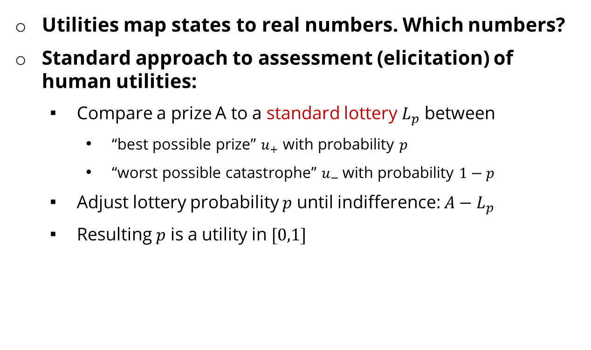
Utilities map states to real numbers. Which numbers?
Standard approach to assessment (elicitation) of human utilities:
Compare a prize A to a standard lottery $L_{p}$ between
“best possible prize” $u_{+}$ with probability $p$
“worst possible catastrophe” $u_{−}$with probability $1−p$
Adjust lottery probability $p$ until indifference: ${A−L}_{p}$
Resulting $p$ is a utility in $[0,1]$
Pay $30
0.999999 0.000001
No change
Instant death
CIS 521 | 38
Notes:
Elicit preferences.
Slide the value until the person becomes indifferent. That’s the way that I can assign a number to U.
How much do you NOT want to pay $30? No change is better than paying $30, instant death is worse. Example: Buy a bike helment to reduce your microports by 1.
Once I find that magical probability that makes you indifferent, then I know U.
If we made it worse, pay $3m be in debt forever.

Slide 99
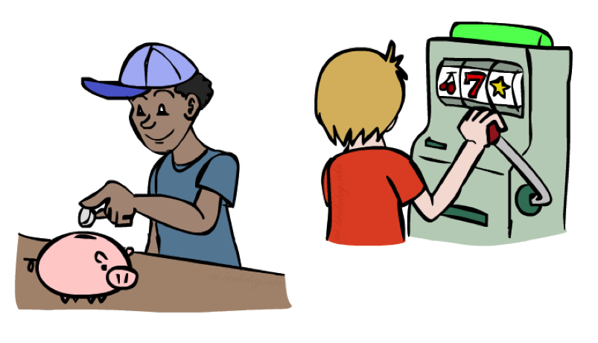
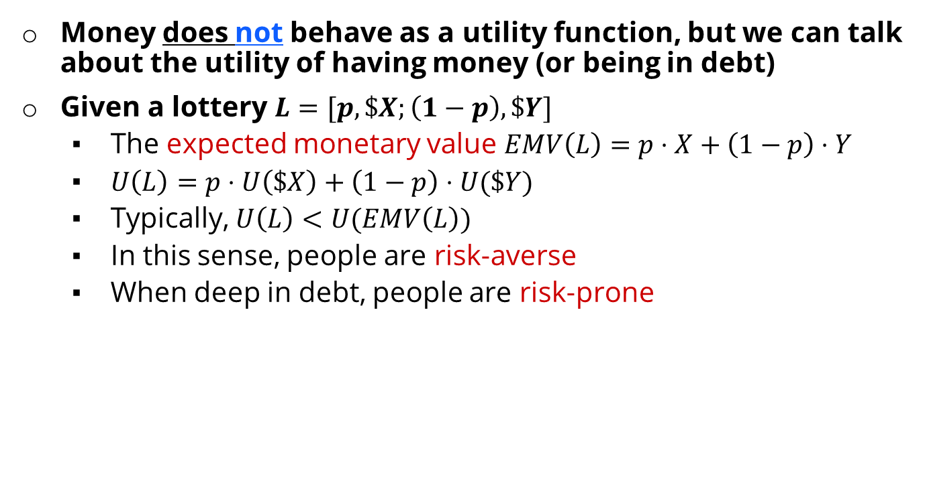
Money
Money does not behave as a utility function, but we can talk about the utility of having money (or being in debt)
Given a lottery $L=[p, \$X;\left(1−p\right), \$Y]$
The expected monetary value $EMV\left(L\right)=p⋅X+\left(1−p\right)⋅Y$
$U\left(L\right)=p⋅U\left(\$X\right)+\left(1−p\right)⋅U(\$Y)$
Typically, $U\left(L\right)<U(EMV\left(L\right))$
In this sense, people are risk-averse
When deep in debt, people are risk-prone
CIS 521 | 39
Notes:
How about money? Can we use money as a utility scale? No! It’s not a good utility scale. We can talk about the utility of money, but it itself isn’t a good utility scale. Why not?
Imagine a lottery where you get X dollars or Y dollars.
Obviously, how good this is depends on X, Y and p.
Typically a utility of a lottery over money is worth less than its equivalent monetary value.
You’d rather have a smaller amount that is guaranteed.
How many of you would like a million dollars?
How many of you would like a billion dollars? How much more? 1000x more? Maybe not?
Let’s say I gave you a billion. Now how much do you want a million? Not much.
Diminishing returns. I’m told after your first billion, your second billion has less utility.
Same thing in the negative. Once you’re $1b in debt, whatever, you’re too big.

Slide 100
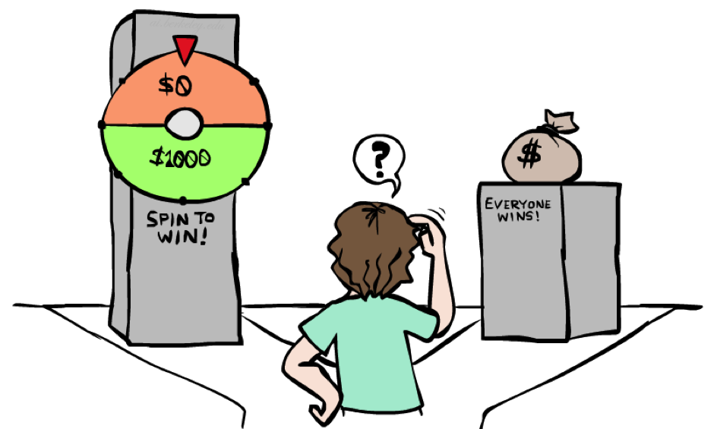
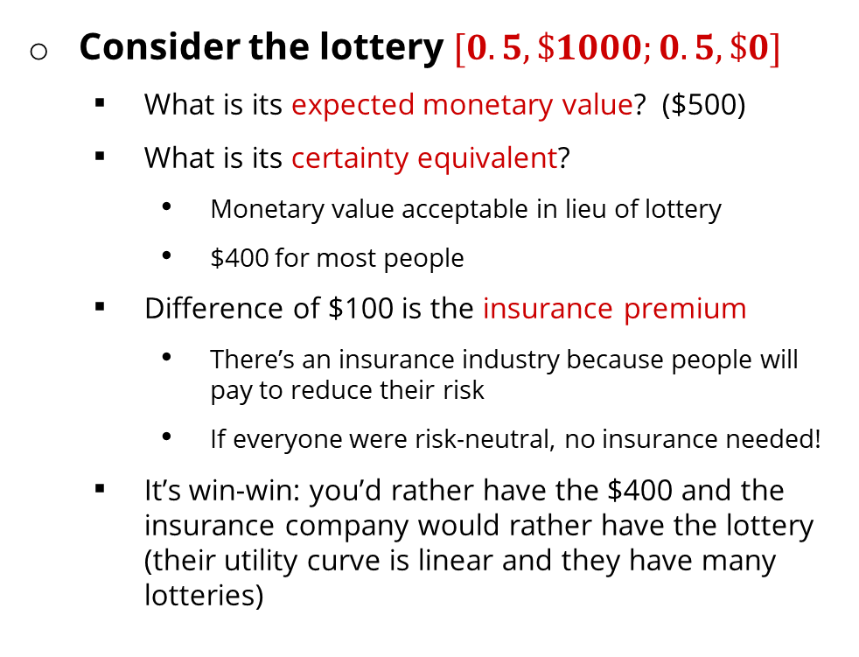
Example: Insurance
Consider the lottery $[0.5, \$1000;0.5, \$0]$
What is its expected monetary value? ($500)
What is its certainty equivalent?
Monetary value acceptable in lieu of lottery
$400 for most people
Difference of $100 is the insurance premium
There’s an insurance industry because people will pay to reduce their risk
If everyone were risk-neutral, no insurance needed!
It’s win-win: you’d rather have the $400 and the insurance company would rather have the lottery (their utility curve is linear and they have many lotteries)
CIS 521 | 40
Notes:
Lottery example = $1000 computer, 50% chance that you’ll get it stolen, in which case you are left with $0.
Certainty equivalent. That’s how much money you would be willing to trade this lottery for. Trade uncertainty for certainty.
Certainty equivalent. How much would you trade this lottery for? How many would trade this for $10? How about $900? How about $400?
Because of these preferences there are things like insurance.
Is insurance just a scam? No, it’s win-win!

Slide 101

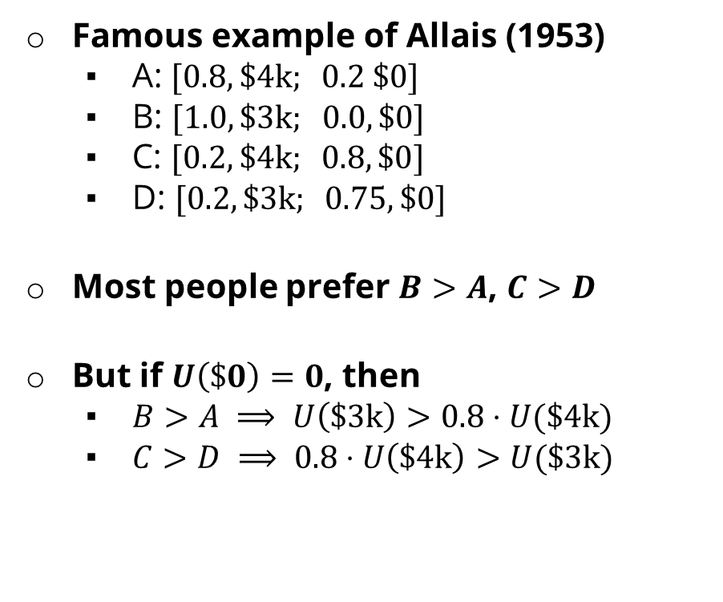
Example: Human Rationality?
Famous example of Allais (1953)
A: $[0.8, \$\text{4}\text{k}; 0.2 \$0]$
B: $[1.0, \$3\text{k}; 0.0, \$0]$
C: $[0.2, \$\text{4}\text{k}; 0.8, \$0]$
D: $[0.2, \$3\text{k}; 0.75, \$0]$
Most people prefer $B>A$, $C>D$
But if $U\left(\$0\right)=0$, then
$B>A ⟹ U\left(\$3\text{k}\right)>0.8⋅U(\$4\text{k})$
$C>D ⟹ 0.8⋅U\left(\$\text{4}\text{k}\right)>U(\$\text{3}\text{k})$
CIS 521 | 41
Notes:
Are humans perfectly rational? Here’s a classic experiment
B is the clear winner.
C is the winner.
Most people prefer C over D.
Multiply C and D by 4 and get the opposite conclusion 0.2*4 = 0.8, 0.25*4 = 1, so 0.8 U($4k) > 1.0 * U($3k)
So what the heck? You’re making irrational preferences? Are you irrational or did I do something wrong?
There’s a lot going on.
Prize B said 100% chance of 3k. 0 is actually important.
What do you get if you choose A, and you win $0? You get the feeling of stupidity.

